Slide 1

Neural Question Generation with
Answer Pivot
Xiaochuan Wang, BingningWang
Ting Yao, Qi Zhang, Jingfang Xu
Sogou
Notes:
Hello everyone im Bingning Wang from Sogou, this is my short introduction of work in neural question generation, aka NQG.

Slide 2
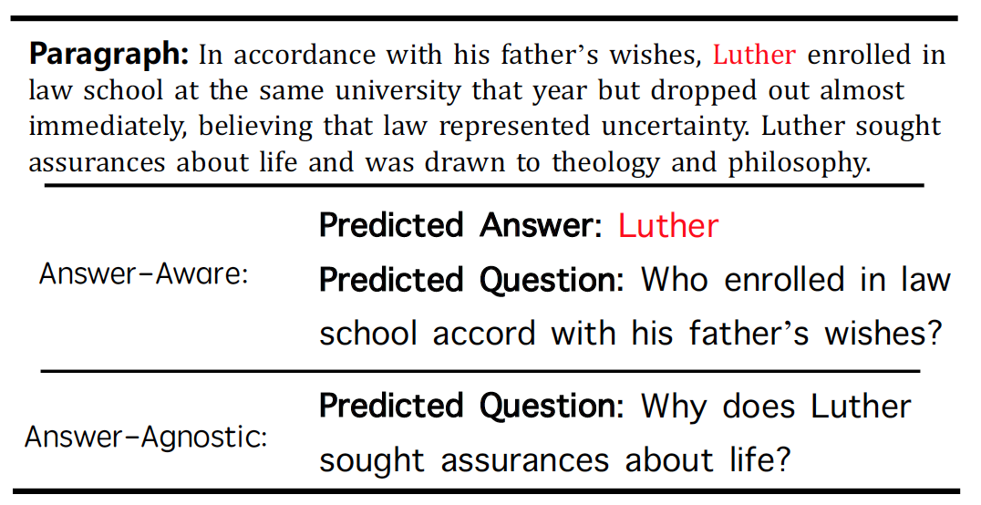
Previous works on Neural Question Generation
Answer aware NQG systems sometimes generate trivial questions, which is meaningless to the downstream tasks
Answer agnostic NQG systems sometimes generate irrelevant questions.
Notes:
Previous works on NQG are mainly divided into two steams, the answer aware and and answer agnositc. In answer aware NQG, in addition to the original document, we also have have the target answer from which the question is generated. However, in answer aware NQG, the systems sometimes generate trivial questions which are just the simple modification to the original sentence in the paragraph, without considering its meaning. On the other hand, in the answer agnostic nqg the systems sometimes generate irrelevant questions to the document.

Slide 3
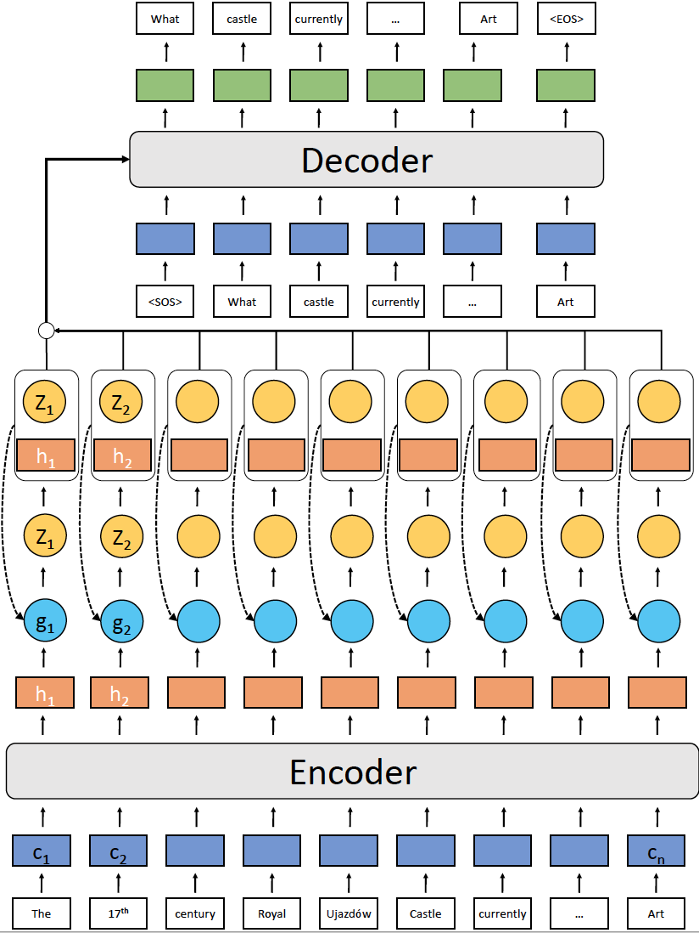
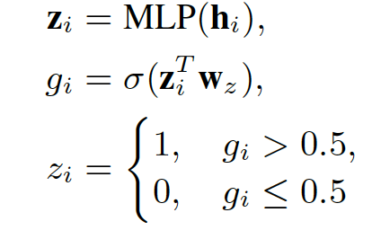
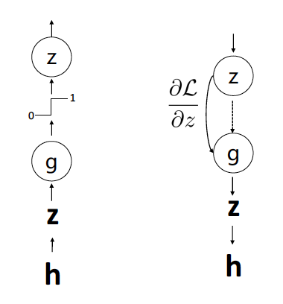
Model architecture
We treat the answer as a hidden variable (inductive bias) to guide the generation of the question.
Gradient straight through estimator:
Notes:
In this paper, we proposed to use the answer information to guide the question generation process, in which we treat the answer as a hidden pivot, the system must induce this hidden variable itself, and use this hidden answer information to generate question. Due to the discreate of the hidden variable, we use straight through estimator to train the model.

Slide 4
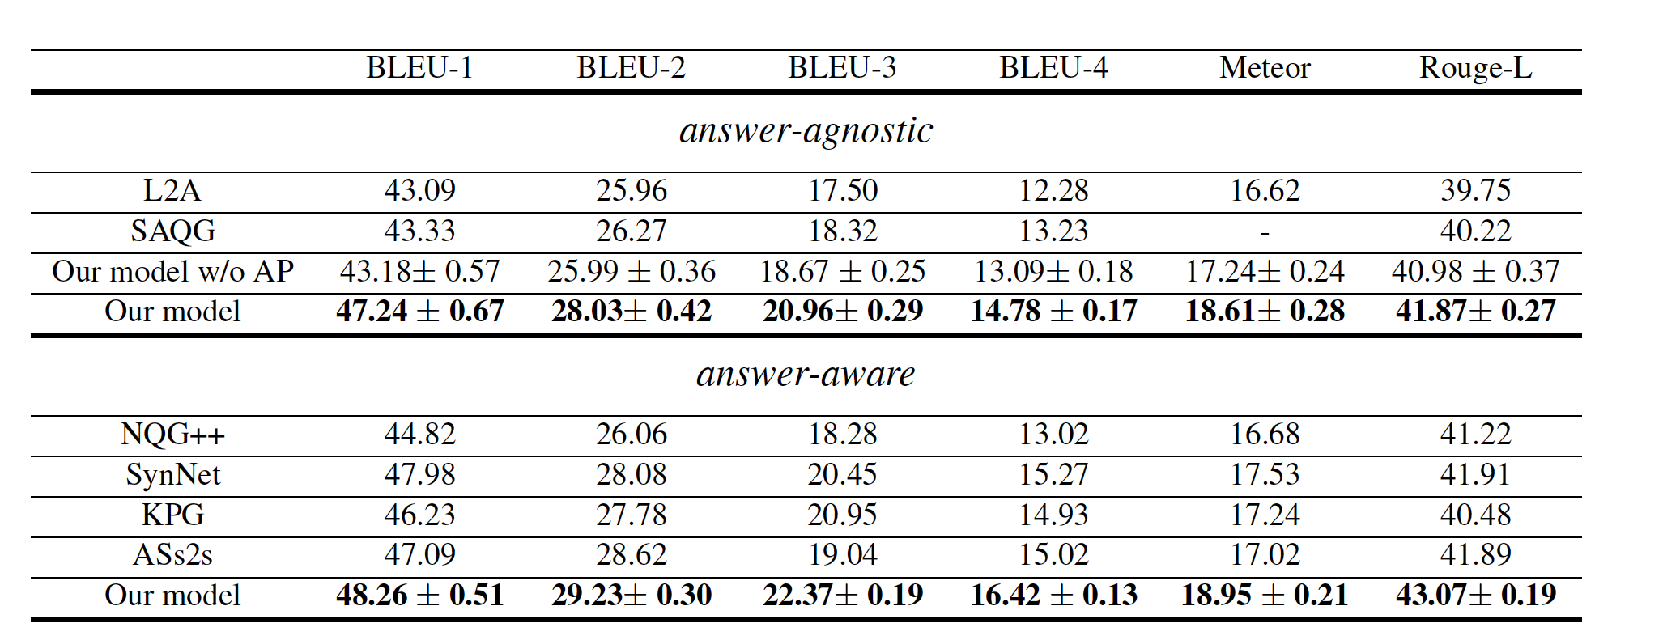
Result on SQuAD
Notes:
We evaluate our methods on SQuAD, Experimental result on both answer-agnostic and answer aware NQG demonstrate the advantage of our proposed methods. Thank you.

